Slide 1
Topic 10 – Bit Manipulation

Slide 2
Positional number system
The Hindu-Arabic numeral system, which is base 10, is the most commonly used system in the world
The system evolved in India around 300BC, with zero identified about 1,000 years later, popularized by Fibonacci and spreading across Europe by around 1400
The ancient Babylonians used a base 60 system
The Mayans used a base 20 system

Slide 3
Positional number system
There have been arguments for a base 12 system

Slide 4
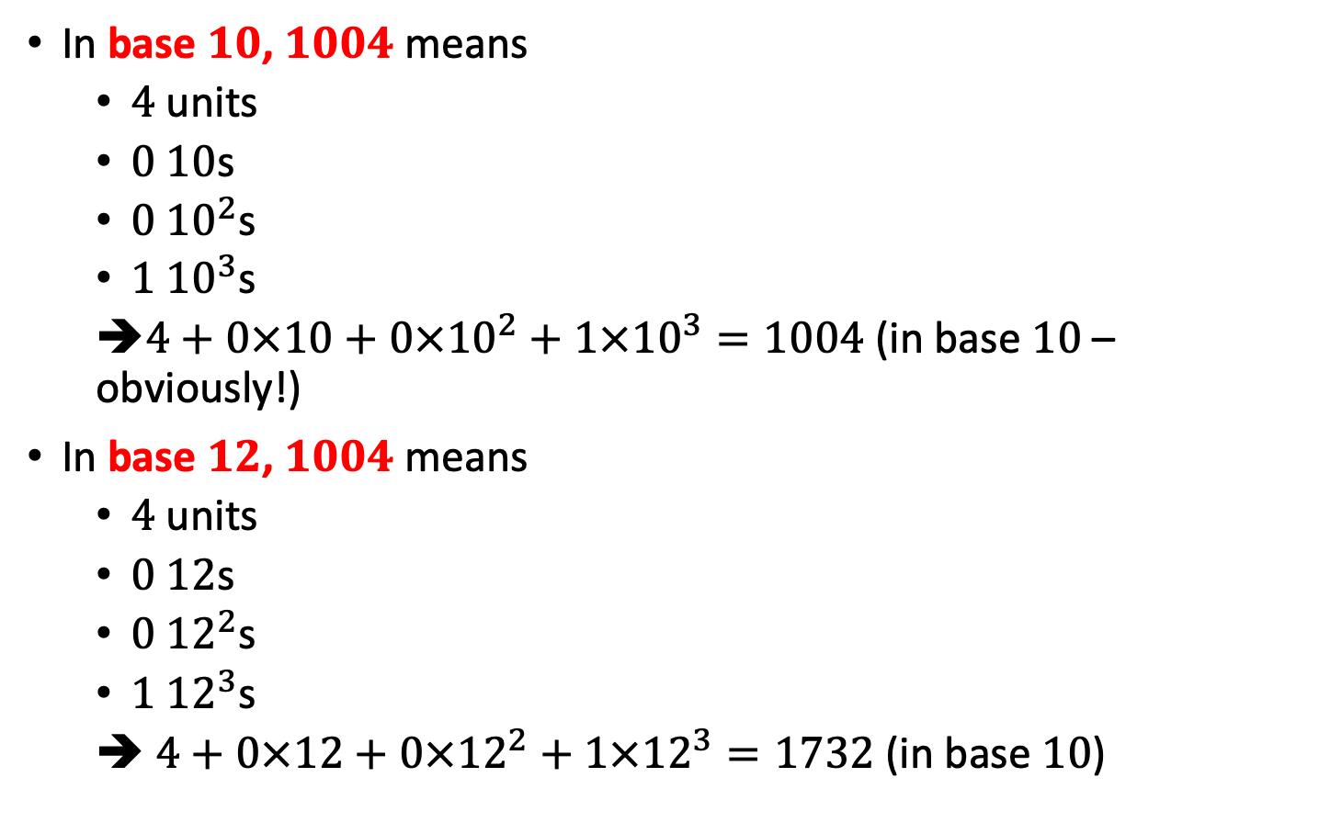
Positional number system
In base $10$, $1004$ means
$4$ units
$0$ $10$s
$0$ ${10}^{2}$s
$1$ ${10}^{3}$s
➔$4+0×10+0×{10}^{2}+1×{10}^{3}=1004$ (in base $10$ – obviously!)
In base $12$, $1004$ means
$4$ units
$0$ $12$s
$0$ ${12}^{2}$s
$1$ ${12}^{3}$s
➔ $4+0×12+0×{12}^{2}+1×{12}^{3}=1732$ (in base $10$)

Slide 5
Converting base
To convert a number in base 10 to any other base, we need to figure out how many units of each power it has
E.g. convert 1004 from base 10 to base 12
Find how many 123s it has: 0
Find out how many 122s it has: 6 with remainder 140
Find out how many 12s it has: 11 with remainder 8
Find out how many units it has: 8
So the answer is 6-11-8 or 6elv8
1004 % 12 = 8 ➔ 1004 – 8 = 996 ➔ 996 / 12 = 83
83 % 12 = 11. ➔ 83 – 11 = 72 ➔ 72 / 12 = 6
6 % 12 = 6 ➔ 6 – 6 = 0 ➔ 0 / 12 = 0

Slide 6
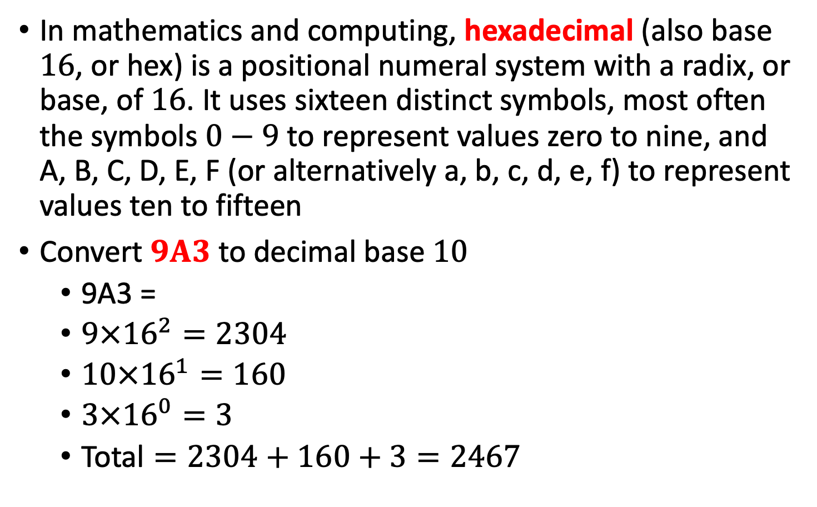
Converting base
In mathematics and computing, hexadecimal (also base $16$, or hex) is a positional numeral system with a radix, or base, of $16$. It uses sixteen distinct symbols, most often the symbols $0−9$ to represent values zero to nine, and A, B, C, D, E, F (or alternatively a, b, c, d, e, f) to represent values ten to fifteen
Convert $9A3$ to decimal base $10$
9A3 =
$9×{16}^{2}=2304$
$10×{16}^{1}=160$
$3×{16}^{0}=3$
$\text{Total}=2304+160+3=2467$

Slide 7
Bit Manipulation
Why does Bender freak out when he sees this number in the mirror?

Slide 8
Question
What number is 0101100101? C
A) | 583
B) | 216
C) | 357
D) | 405
E) | 181

Slide 9
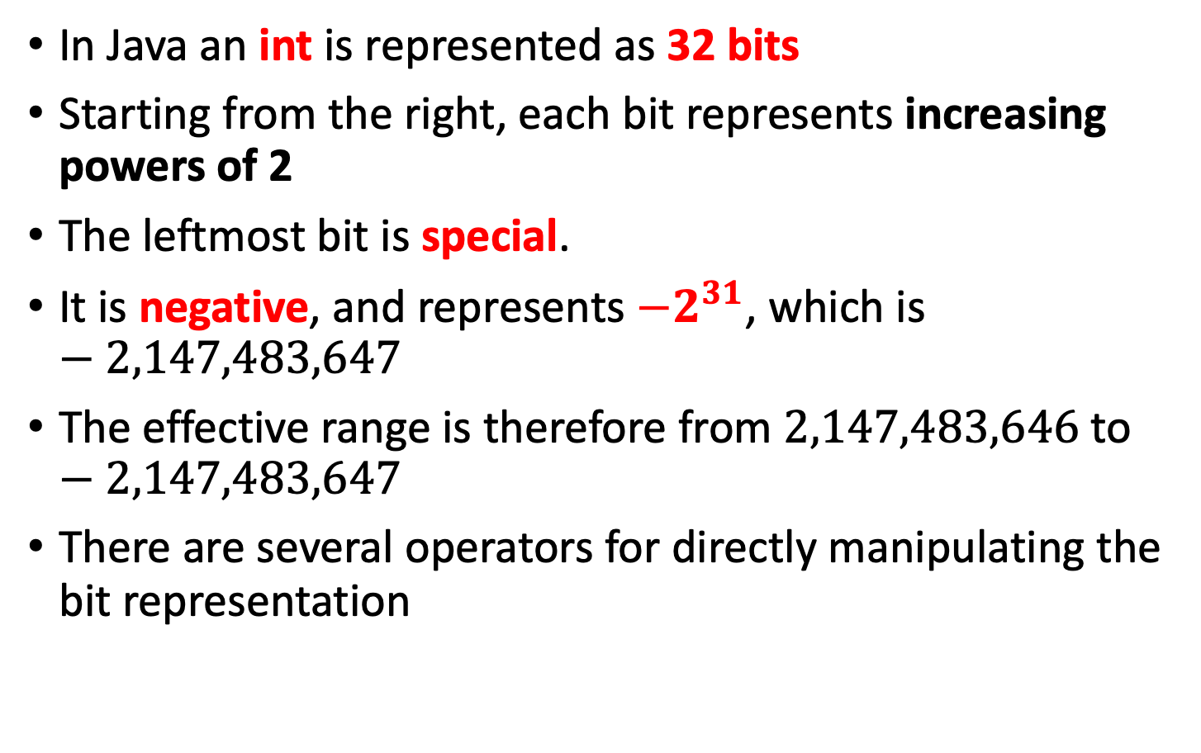
Bit representation
In Java an int is represented as 32 bits
Starting from the right, each bit represents increasing powers of 2
The leftmost bit is special.
It is negative, and represents $−2^{31}$, which is $−2,147,483,647$
The effective range is therefore from $2,147,483,646$ to $−2,147,483,647$
There are several operators for directly manipulating the bit representation

Slide 10
Bit representation
The int value of this 32 bit string is -2^31 + 2^30 + 2^29 which is -536,870,912
This is negative – if the value of this bit is 1 it counts as - 2^31
2³¹ | 2³⁰ | 2²⁹ | 2²⁸ | 2²⁷ | 2²⁶ | 2²⁵ | 2²⁴ | 2²³ | 2²² | 2²¹ | 2²⁰ | 2¹⁹ | 2¹⁸ | 2¹⁷ | 2¹⁶
1 | 1 | 1 | 0 | 0 | 0 | 0 | 0 | 0 | 0 | 0 | 0 | 0 | 0 | 0 | 0
2¹⁵ | 2¹⁴ | 2¹³ | 2¹² | 2¹¹ | 2¹⁰ | 2⁹ | 2⁸ | 2⁷ | 2⁶ | 2⁵ | 2⁴ | 2³ | 2² | 2¹ | 2⁰
0 | 0 | 0 | 0 | 0 | 0 | 0 | 0 | 0 | 0 | 0 | 0 | 0 | 0 | 0 | 0

Slide 11
Big Endian vs Little Endian
Little Endian is used by Java, also PowerPC, ARM, iPhone, Xbox 360 and PS3 and encodes the bytes in this order:
Big Endian is used by Intel (C / C++ depends on the system) and encodes bytes in this order:
2³¹ | 2³⁰ | 2²⁹ | 2²⁸ | 2²⁷ | 2²⁶ | 2²⁵ | 2²⁴ | 2²³ | 2²² | 2²¹ | 2²⁰ | 2¹⁹ | 2¹⁸ | 2¹⁷ | 2¹⁶
1 | 1 | 1 | 0 | 0 | 0 | 0 | 0 | 0 | 0 | 0 | 0 | 0 | 0 | 0 | 0
2¹⁵ | 2¹⁴ | 2¹³ | 2¹² | 2¹¹ | 2¹⁰ | 2⁹ | 2⁸ | 2⁷ | 2⁶ | 2⁵ | 2⁴ | 2³ | 2² | 2¹ | 2⁰
0 | 0 | 0 | 0 | 0 | 0 | 0 | 0 | 0 | 0 | 0 | 0 | 0 | 0 | 0 | 0
2⁷ | 2⁶ | 2⁵ | 2⁴ | 2³ | 2² | 2¹ | 2⁰ | 2¹⁵ | 2¹⁴ | 2¹³ | 2¹² | 2¹¹ | 2¹⁰ | 2⁹ | 2⁸
0 | 0 | 0 | 0 | 0 | 0 | 0 | 0 | 0 | 0 | 0 | 0 | 0 | 0 | 0 | 0
2²³ | 2²² | 2²¹ | 2²⁰ | 2¹⁹ | 2¹⁸ | 2¹⁷ | 2¹⁶ | 2³¹ | 2³⁰ | 2²⁹ | 2²⁸ | 2²⁷ | 2²⁶ | 2²⁵ | 2²⁴
0 | 0 | 0 | 0 | 0 | 0 | 0 | 0 | 1 | 1 | 1 | 0 | 0 | 0 | 0 | 0

Slide 12
Picking out a byte
Say you want to pick out the second byte in a 32-bit integer, you can do it as follows
int num = 3534464; //we want byte 2 of this
int filter = Integer.parseInt
(“00000000111111110000000000000000”,2);
int secondbyte = num & filter;
The bits in the position of a 0 are lost, the bits in the position of a 1 are preserved

Slide 13
Bit representation
Value | Bit representation
0 | 00000000 | 00000000 | 00000000 | 00000000
-1 | 11111111 | 11111111 | 11111111 | 11111111
-2 | 11111111 | 11111111 | 11111111 | 11111110
65535 | 00000000 | 00000000 | 11111111 | 11111111
-65535 | 11111111 | 11111111 | 00000000 | 00000001

Slide 14
Bitwise AND operator (&)
Take the two numbers, convert into bit form, follow the above rules to combine them, and then convert back to an integer value
Bit 1 | Bit 2 | Bit 1 & Bit 2
0 | 0 | 0
1 | 0 | 0
0 | 1 | 0
1 | 1 | 1
int result = 7 & 3;
7 = ...111
3 = ...011
7 & 3 = ...011 = 3
int result = 6 & 3;
6 = ...110
3 = ...011
7 & 3 = ...010 = 2

Slide 15
Bitwise OR operator (|)
Take the two numbers, convert into bit form, follow the above rules to combine them, and then convert back to an integer value
Bit 1 | Bit 2 | Bit 1 | Bit 2
0 | 0 | 0
1 | 0 | 1
0 | 1 | 1
1 | 1 | 1
int result = 11 | 8;
11 = ...1011
8 = ...1000
11 | 8 = ...1011 = 11
int result = 11 | 6;
11 = ...1011
6 = ...0110
11 | 8 = ...1111 = 15

Slide 16
Bitwise XOR operator (^)
Take the two numbers, convert into bit form, follow the above rules to combine them, and then convert back to an integer value
Bit 1 | Bit 2 | Bit 1 ^ Bit 2
0 | 0 | 0
1 | 0 | 1
0 | 1 | 1
1 | 1 | 0
int result = 15 ^ 6;
15 = ...1111
6 = ...0110
15 ^ 6 = ...1001 = 9

Slide 18
Question
What is 2 & 2?
What is 8 | 7?
What is 11 ^ -3?
A) | 0
B) | 1
C) | 2
D) | 3
E) | 4
A) | 7
B) | 9
C) | 11
D) | 13
E) | 15
A) | -10
B) | -5
C) | 1
D) | 8
E) | 11

Slide 19
Bitwise left shift (<<)
Take the number, convert into bit form, shift the bits to the left and fill in the spaces on the right with 0s
int result = 15 << 3;
15 = 00000000 00000000 00000000 00001111
15 << 3 = 00000000 00000000 00000000 01111000
15 << 3 = 120 (15 * 2³)
int result = 116 << 5;
116 = 00000000 00000000 00000000 01110100
116 << 5 = 00000000 00000000 00001110 10000000
116 << 5 = 3,712 (116 * 2⁵)

Slide 20
Bitwise signed right shift (>>)
Take the number, convert into bit form, shift the bits to the right and fill in the spaces on the right with 1s if it’s a negative number, 0s otherwise
int result = 116 >> 3;
116 = 00000000 00000000 00000000 01110100
116 >>3 = 00000000 00000000 00000000 00001110
116 >>3 = 14 which is (around 116 / 2³)
int result = -116 >> 3;
-116 = 11111111 11111111 11111111 10001100
-116 >>3 = 11111111 11111111 11111111 11110001
-116 >>3 = -15 which is (around -116 / 2³)

Slide 21
Bitwise unsigned right shift (>>>)
Take the number, convert into bit form, shift the bits to the right and fill in the spaces with 0s no matter what
int result = 116 >>> 3;
116 = 00000000 00000000 00000000 01110100
116 >>>3 = 00000000 00000000 00000000 00001110
116 >>>3 = 14 which is (around 116 / 2³)
int result = -116 >> 3;
-116 = 11111111 11111111 11111111 10001100
-116 >>>3 = 00011111 11111111 11111111 11110001
-116 >>>3 = 536,870,897

Slide 22
Bitwise complement (~)
Take the number, convert into bit form, flip every 1 to a 0 and vice versa
This operation on n is the same as (n*-1) - 1
int result = ~116;
116 = 00000000 00000000 00000000 01110100
~116 = 11111111 11111111 11111111 10001011
~116 = -117

Slide 23
Question
What is 2 << 3?
What is 8 >> 2?
A) | 2
B) | 4
C) | 8
D) | 16
E) | 32
A) | 0
B) | 1
C) | 2
D) | 4
E) | 8

Slide 24
Question
What is -11 >>> 1 given that -1 >>> 1 is 2,147,483,647?
What is ~7?
A) | -2,147,483,647
B) | -2,147,483,631
C) | -15
D) | 2,147,483,642
E) | 2,147,483,647
A) | -6
B) | -7
C) | -8
D) | -9
E) | -10

Slide 25
Interview question
Explain what the following code does:
((n & (n-1) == 0)
What does it mean if A & B == 0?
It means that A and B never have a 1 bit in the same place
So if n & (n-1) == 0, then n and n-1 never share a 1

Slide 26
Interview question
What does n-1 look like (as compared with n)?
Try doing subtraction by hand in base 2
When you subtract 1 from a number you look at the least significant bit
If it’s a 1 you change it to a 0 and you’re done
If it’s a zero, you must borrow from a larger bit, so you go to increasingly larger bits, changing each from a zero to a 1, until you find a 1
You flip that to a 0 and you’re done
 | 1 | 1 | 0 | 1 | 0 | 1 | 1 | 0 | 0 | 0
– |  |  |  |  |  |  |  |  |  | 1
= | 1 | 1 | 0 | 1 | 0 | 1 | 0 | 1 | 1 | 1

Slide 27
Interview question
So what does n & (n – 1) indicate?
n and (n – 1) must have no 1s in common
Therefore all the Xs below must be zeroes
So the number n must look like this: 00001000
n is therefore a power of two
((n & (n-1)) == 0) checks if n is a power of 2
 | X | X | X | X | X | X | 1 | 0 | 0 | 0
– |  |  |  |  |  |  |  |  |  | 1
= | X | X | X | X | X | X | 0 | 1 | 1 | 1

Slide 28
Interview question
Subtract two numbers without using minus
Bitwise complement gives you the negative version of a number - 1
int first = 10;
int second = 3;
result = first + ~second + 1;

Slide 29
Interview question
Add two numbers together without using +, - , * or /
public int addition(int a, int b) {
if(b==0) {
return a;
} else {
sum = a^b;
carry = (a&b)<<1;
return addition(sum,carry);
}
}

Slide 30
Question
What is ~4 << ((5 & 3) | 1)? B
A) | -19
B) | -10
C) | 1
D) | 7
E) | 13

